Slide 1
Chapter 6
Dynamic Documents
with JavaScript
Programming the World Wide Web
Fourth edition
By Robert W. Sebesta

Slide 2
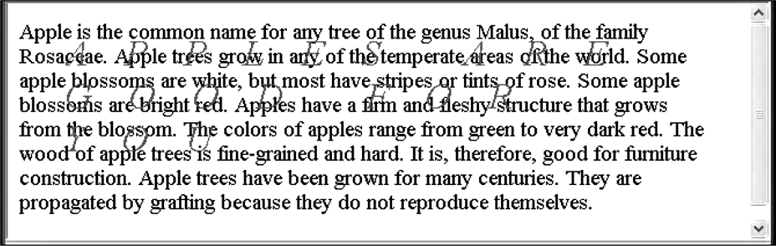
Figure 6.1 Display of absPos.html

Slide 3
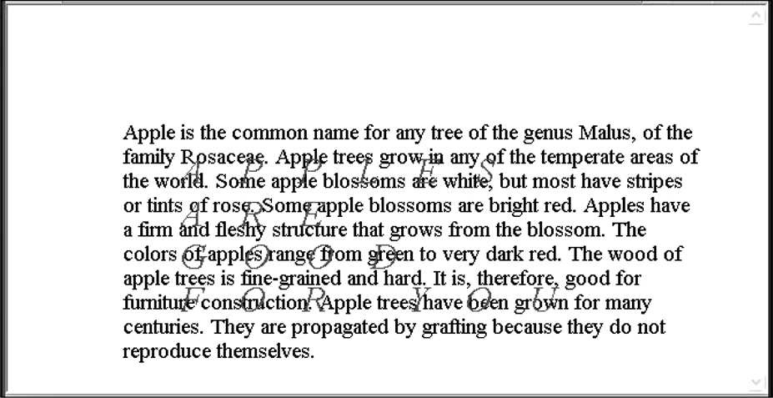
Figure 6.2 Display of absPos2.html

Slide 4
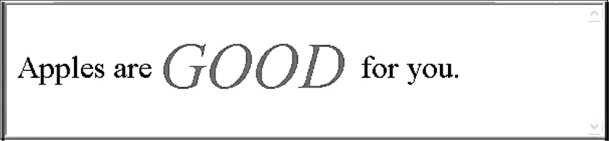
Figure 6.3 Display of relPos.html

Slide 5
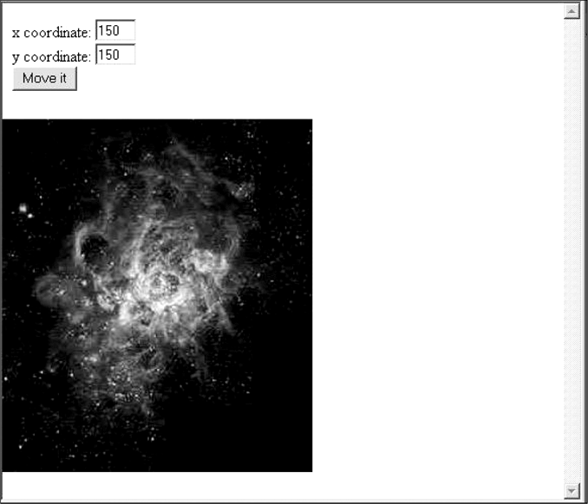
Figure 6.4 Display of mover.html (before pressing the Move It button)

Slide 6
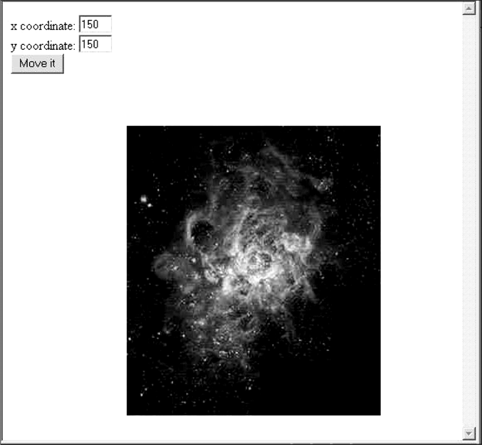
Figure 6.5 Display of mover.html (after pressing the Move It button)

Slide 7
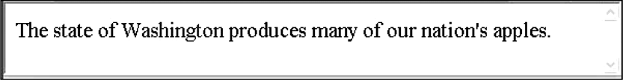
Figure 6.6 Display of dynLink.html with the cursor not over the link

Slide 8
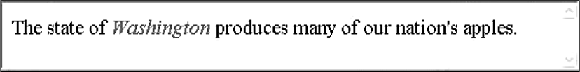
Figure 6.7 Display of dynLink.html with the mouse cursor over the link

Slide 9
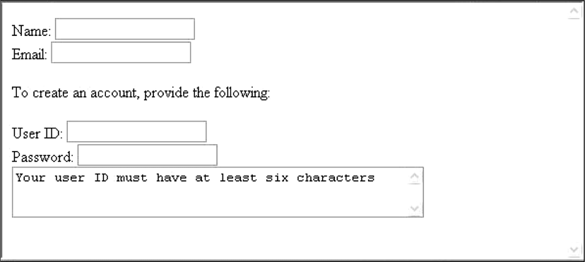
Figure 6.8 Display of dynValue.html

Slide 10
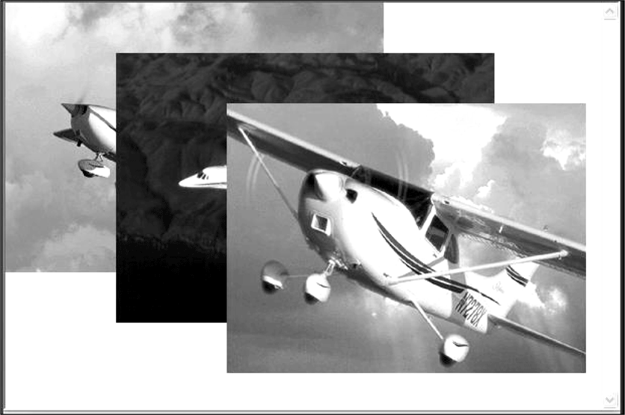
Figure 6.9 The initial display of stacking.html (photographs courtesy of Cessna Aircraft Company)

Slide 11
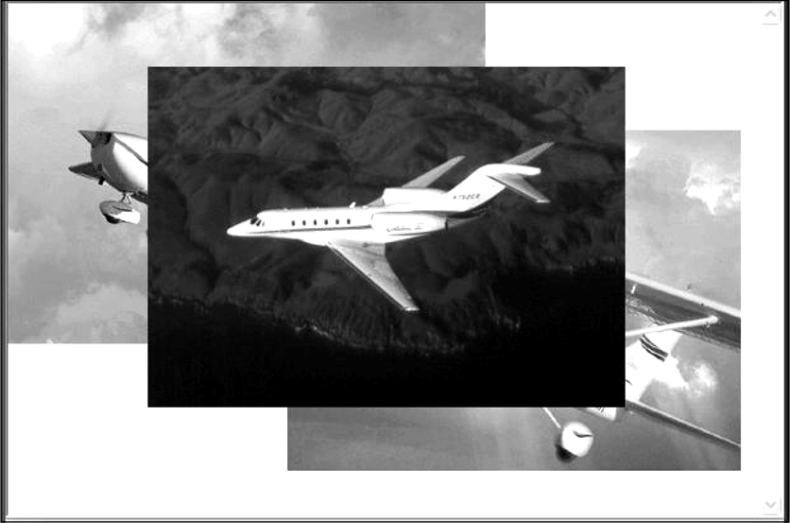
Figure 6.10 The display of stacking.html after clicking the second image (photographs courtesy of Cessna Aircraft Company)

Slide 12
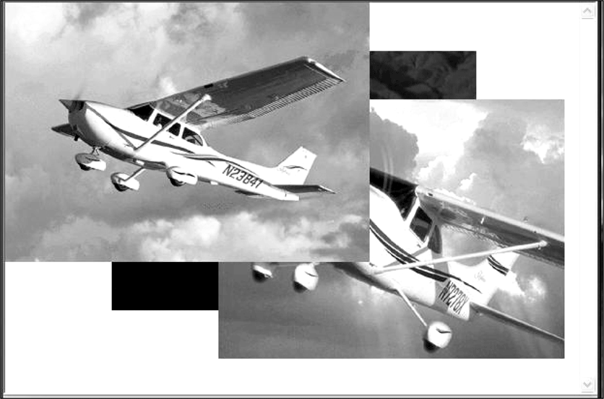
Figure 6.11 The display of stacking.html after clicking the bottom image (photographs courtesy of Cessna Aircraft Company)

Slide 13
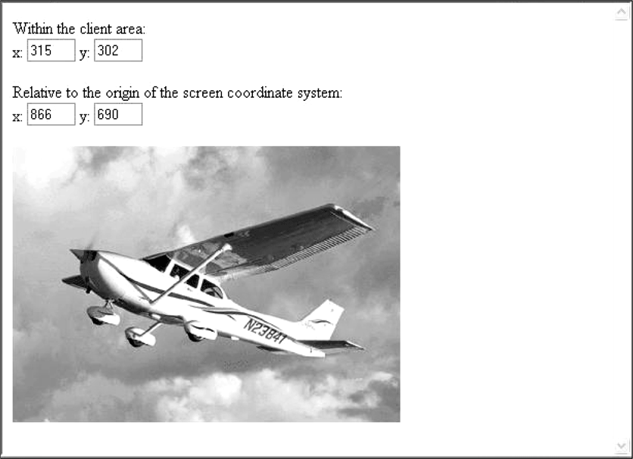
Figure 6.12 Display of where.html (the cursor was in the tail section of the plane)

Slide 14
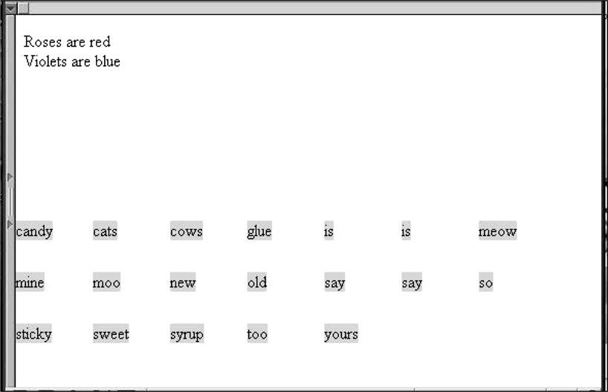
Figure 6.13 Display of dragNDrop.html

